Slide 1
CSS
{Cascading Style Sheet}

Slide 2
CSS
CSS stands for CASCADING STYLE SHEET
CSS is the language we use to style an HTML document.
CSS describes how HTML elements should be displayed.

Slide 3
Types of css
1. Internal CSS
2. Inline CSS
3. External CSS

Slide 4
INTERNAL CSS
An internal style sheet may be used if one single HTML page has a unique style

Slide 5
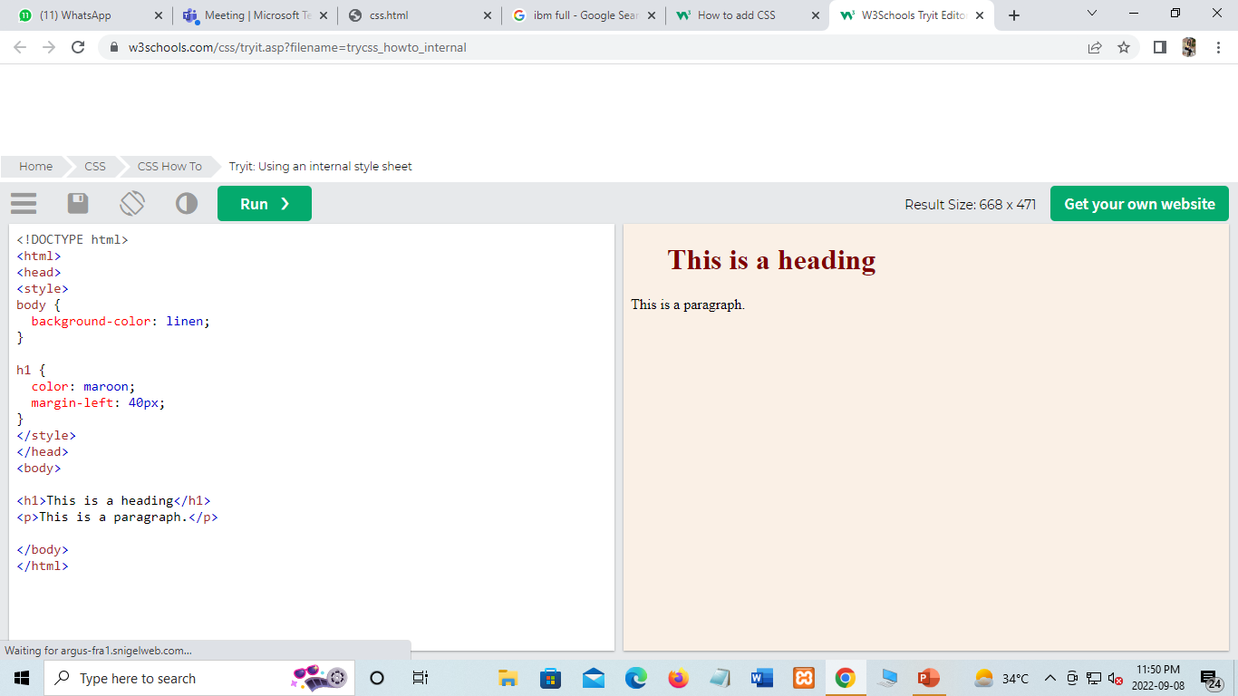
Example of Internal CSS
Internal CSS Code

Slide 6
Inline css
An inline style may be used to apply a unique style for a single element.

Slide 7

Example of Inline CSS
Inline CSS Code

Slide 8
External css
Each HTML page must include a reference to the external style sheet file inside the <link> element, inside the head section.
<html> <head> <link rel="stylesheet" href="mystyle.css"> </head> <body> <h1>This is a heading</h1> <p>This is a paragraph.</p> </body> </html>

Slide 9
An external style sheet can be written in any text editor, and must be saved with a .css extension.
The external .css file should not contain any HTML tags.
Here is how the "mystyle.css" file looks:
"mystyle.css“[File Name]
body { background-color: lightblue; } h1 { color: navy; margin-left: 20px; }

Slide 10
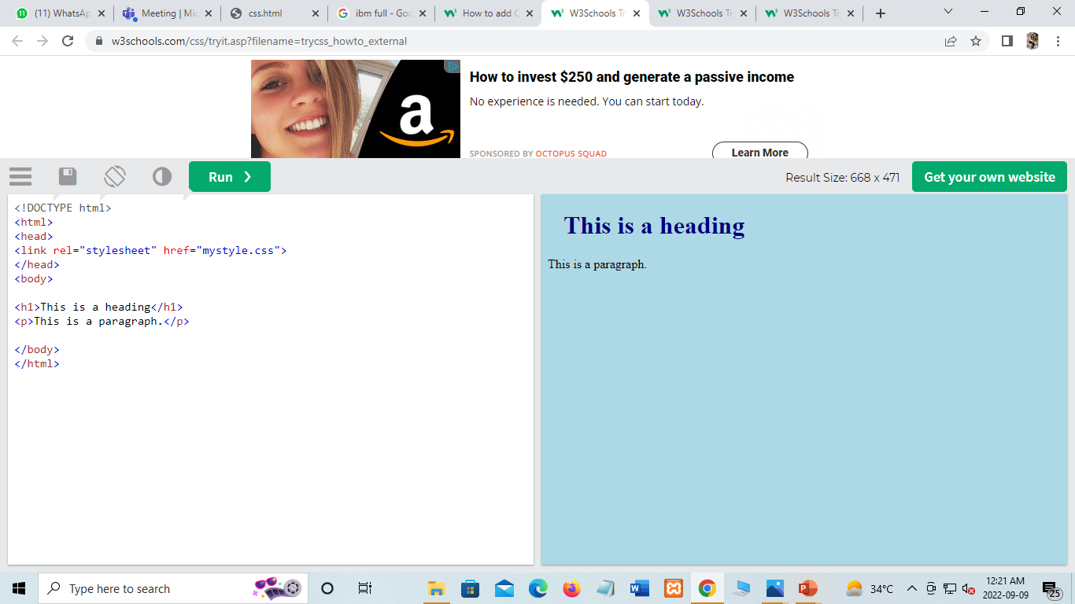
Example of External CSS
External CSS code

Slide 11
THANKYOU!
Ꙭ
꙾

